Slide 1

Mobile Application Development
BCS – 6
Instructor Name: Junaid Ali Khan

Slide 2
Course evaluation (Theory)
4 Quizzes – no extra quiz (15 Marks)
4 Assignments (10 Marks)
Midterm (25 Marks)
Terminal Exam (50 marks)

Slide 3
Course evaluation (Lab)
Lab Tasks – each lab (25 Marks)
Lab Mini Project as Midterm (25 Marks)
Final Lab Project (50 Marks)

Slide 4
Attendance policy

Slide 5

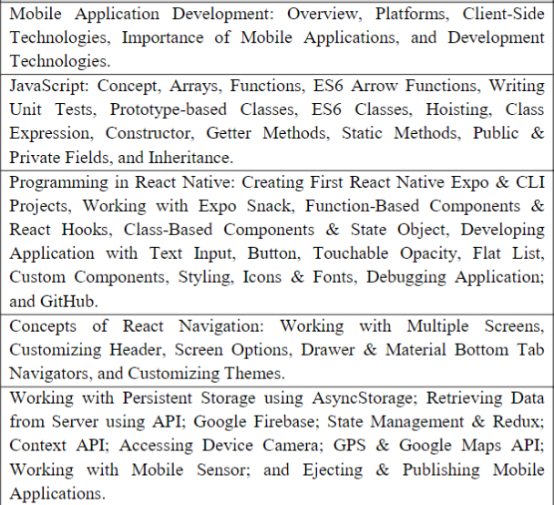

About Course
1 week
2 weeks
5 weeks
2-3 weeks
4 weeks
Notes:
https://www.youtube.com/watch?v=FTFaQWZBqQ8 Figma Learning Tutorial

Slide 6

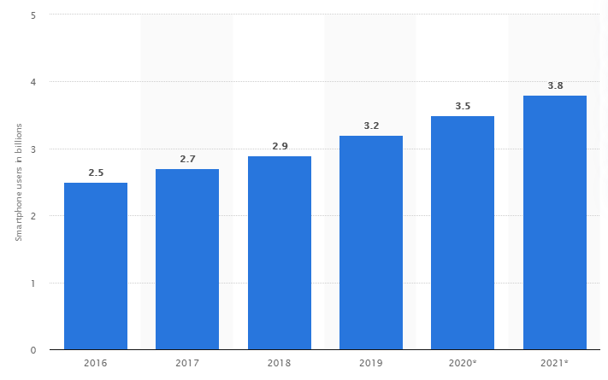

smartphone users worldwide from 2016 to 2021
Source: https://www.statista.com/

Slide 7
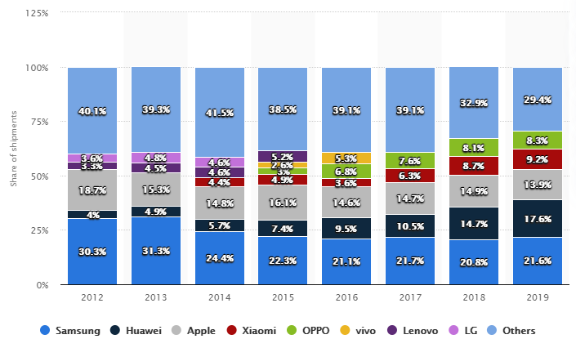
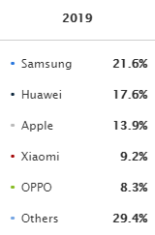
smartphone shipments worldwide from 2012 to 2019
Source: https://www.statista.com/

Slide 8


Mobile platforms
Google Android and Apple iOS have 98% of the global market share for operating systems
Android’s market share will reach 87% in 2022, forecasts suggest

Slide 9


Native mobile app development

Slide 10
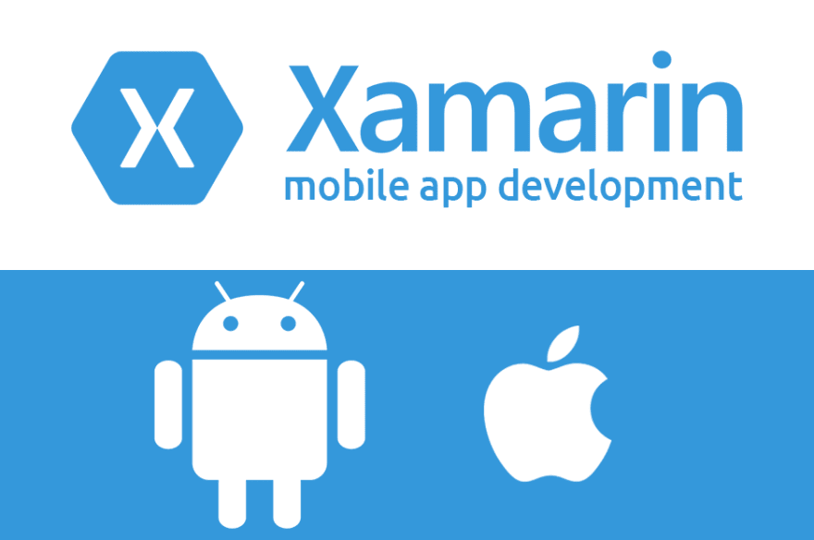


Hybrid Mobile APP Development

Slide 11

About Course

